Slide 1
Car price prediction
Submitted by-
Ashish chand

Slide 2
Car price prediction : problem statement
Due to the covid -19, Many businesses are going down. There Online business is must market now.
With the covid 19 impact in the market, we have seen lot of changes in the car market. Now some cars are in demand hence making them costly and some are not in demand hence cheaper.
One of our clients works with small traders, who sell used cars. With the change in market due to covid 19 impact, our client is facing problems with their previous car price valuation machine learning models.
So, they are looking for new machine learning models from new data. We have to make car price valuation model.

Slide 3
Solution
The client who used to sell used cars is now having problem doing that .
We are required to model the price of cars with the available independent variables. This model will then be used by the management to understand how exactly the prices vary with the variables. They can accordingly manipulate the strategy for selling the car and concentrate on areas that will yield high returns.
Further, the model will be a good way for the management to understand the pricing dynamics of a new market .

Slide 4
EXPLORATORY DATA ANALYSIS
Exploratory Data Analysis(EDA) is an approach of analyzing data sets to summarize their main characteristics, often using statistical graphics and other data visualization methods.
Here we check our data and understand what kind of data is present to us, it is supervised or unsupervised and then check the output/ target column is continuous or categorical.
Then visualize our data with the help of different plots with the help of python libraries such as Matplotlib and Seaborn.

Slide 5
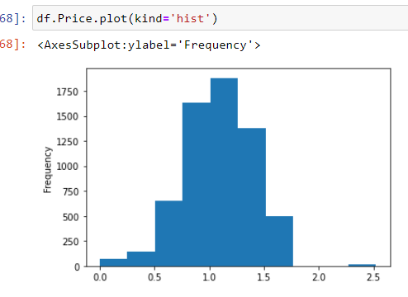
Eda Contd…
The plots we used are:
1 → A histogram is representation of the distribution of numerical data, where the data are binned and the count for each bin is represented. Here histogram is used to check the distribution of data among the different numerical features.

Slide 6
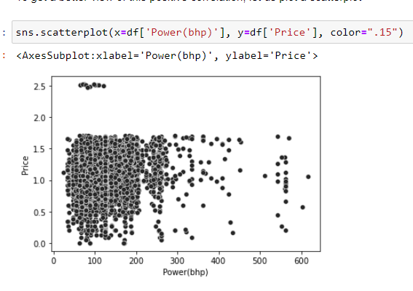
Visualizations..
2.Scatterplot to see the distribution of data among two columns. Scatter plots are used to observe relationship between variables and uses dots to represent the relationship between them.

Slide 7
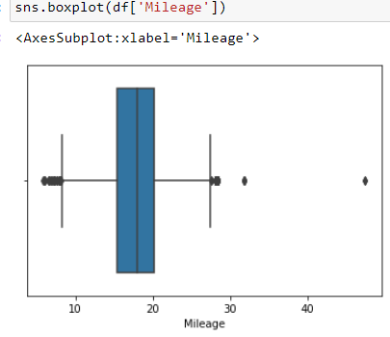
Eda contd..
3. Box plot : A Box Plot is also known as Whisker plot is created to display the summary of the set of data values having properties like minimum, first quartile, median, third quartile and maximum.

Slide 8
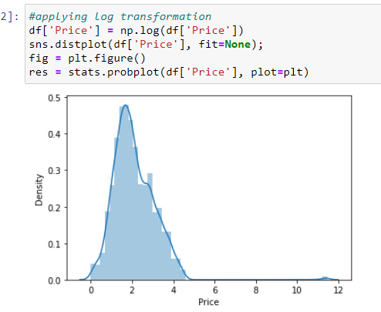
EDA
4. Distribution plot : The seaborn.distplot() function is used to plot the distplot. The distplot represents the univariate distribution of data i.e. data distribution of a variable against the density distribution.

Slide 9
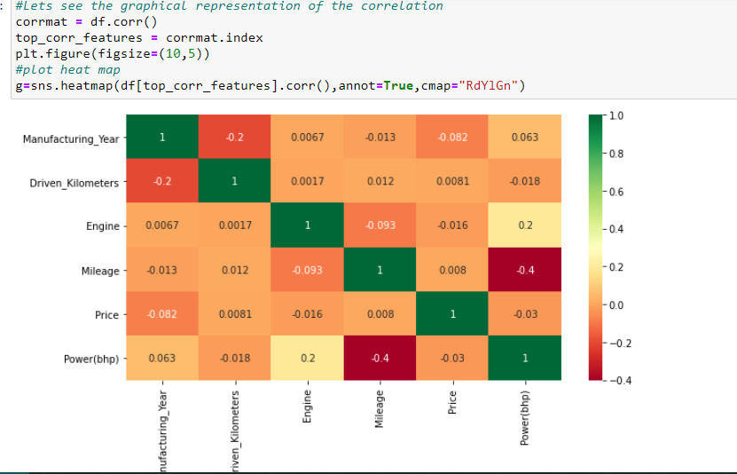
Eda..
5. Heatmap is used to see the correlation of columns.

Slide 10
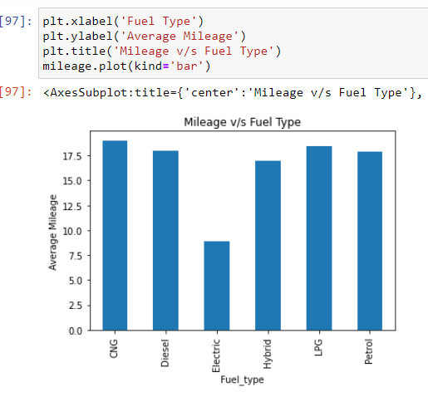
Eda contt…
Bar Plot : A bar plot or bar chart is a graph that represents the category of data with rectangular bars with lengths and heights that is proportional to the values which they represent.

Slide 11
Data Preprocessing
Step 1: Dropping unnecessary variables
remove those which are not actually related to our prediction like One Id number.
Step 2: Checking the correlation
Now check the column which are highly correlated with the target column i.e. Target column.
Manufacturing year ,Engine(in CC) and power(bhp) are high correlated with the Price.
Step 3: Changing the data type , convert the data type with the help of astype() function
Step 4: Clean the column values.

Slide 12
Cont..
Making the target column Normally distributed as it contains price whose values were in lakhs and thousands and when we remove lakhs it get widely distributed.
After that perform the Univariate , Bivariate Analysis of the data with the help of the graph.
Maserati is the very expensive vehicle.
Lamborghini has the highest power.
Maruti and hyundai car brands has the most number of selling cars in India.

Slide 13
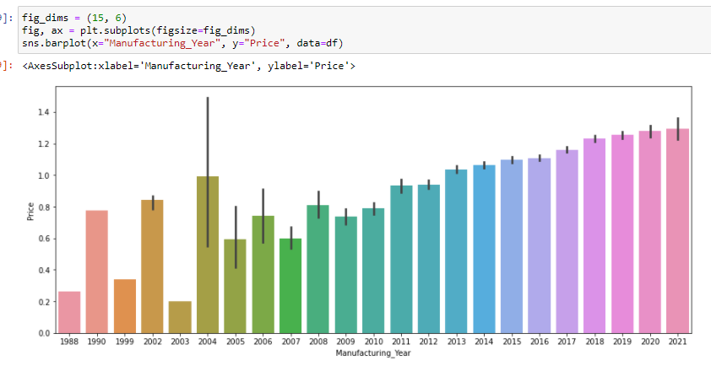
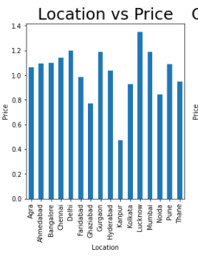
Cont.
Step 4 : Checking the relationship with features and price graphically.
Using the plots to check the relationship between the different columns and the target column (i.e.Price).

Slide 14
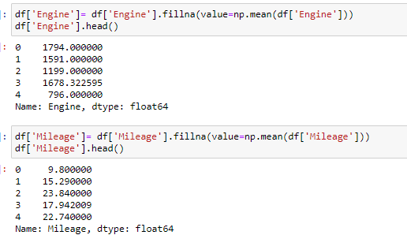
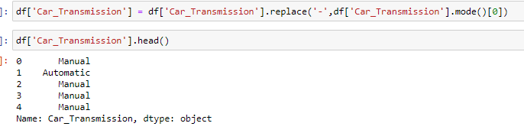
contt
Filling the missing values of columns with the “with mean of the column”.

Slide 15
Contd..
Checking the Price column which is the target column:
Shows that the data is not normally distributed.
Performing the log transformation
Storing the value in actual column.

Slide 16
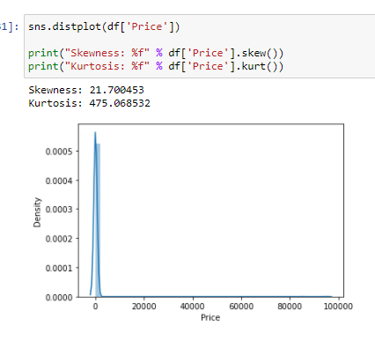
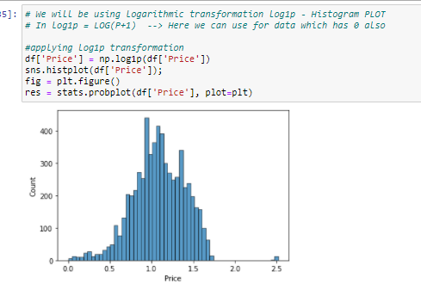
Contd..
Representation of last steps.
First fig. is before the log transformation in price.
Second fig. is after the log transformation in price.

Slide 17
FE cont.
Checking skewness into the data And removing it with the help of log1p method.
Converting the categorical columns into numerical with the help of the preprocessing technique i.e. Label Encoder.
Concating the train and test data but dropping the target column and storing into a variable.
Removing the outliers with the help of zscore method.
Splitting the dataset into x and y for the model training and predicting.
Where x variable contain all the dependent columns except target column. While y contains only Target column i.e. Price.

Slide 18
Model selection
Step 1: Splitting the dataset into Training and Testing for the model prediction.
Step 2: Using Machine learning Algorithm:
1. Linear Regression
2. Lasso
3. Ridge
4. SVR
5. Random Forest Regressor
6. KNN

Slide 19
Model Evaluation Metrics
Mean absolute error : (MAE) represents the difference between the original and predicted values extracted by averaged the absolute difference over the data set.
Mean squared error: (MSE) represents the difference between the original and predicted values extracted by squared the average difference over the data set.
Root Mean squared error: (RMSE) is the error rate by the square root of MSE.
R2 score : R-squared (Coefficient of determination) represents the coefficient of how well the values fit compared to the original values. The value from 0 to 1 interpreted as percentages. The higher the value is, the better the model is.
Cross-validation is a technique that is used for the assessment of how the results of statistical analysis generalize to an independent data set. Cross-validation is largely used in settings where the target is prediction and it is necessary to estimate the accuracy of the performance of a predictive model.

Slide 20
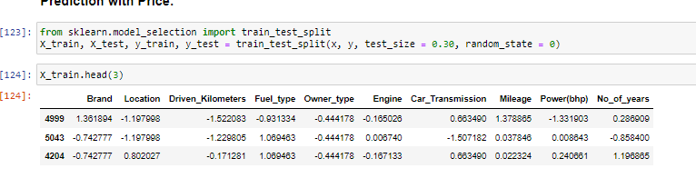
Contt..
Step 1 : Splitting the data into the train test dataset.

Slide 21
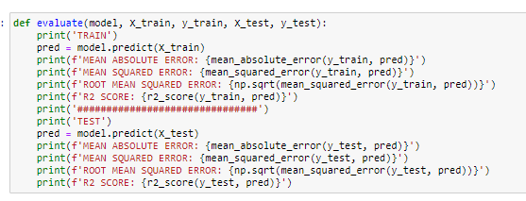
Model contt..
Step 2: Model Training
Creating a function and run all the models on it.

Slide 22
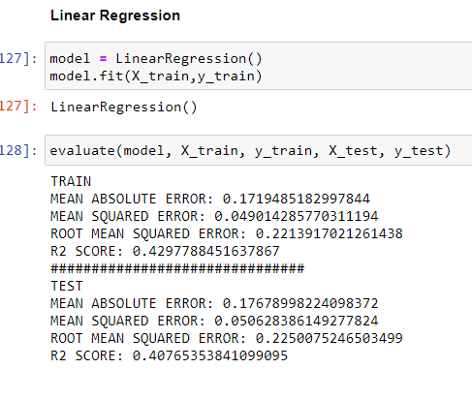
Model training
1 . Linear Regression : Linear regression analysis is used to predict the value of a variable based on the value of another variable. The variable you want to predict is called the dependent variable. The variable you are using to predict the other variable's value is called the independent variable.

Slide 23
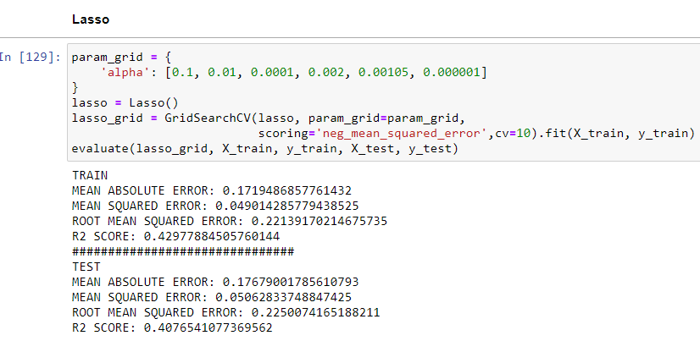
Contd..
2. Lasso : Lasso regression is a regularization technique. Lasso Regression uses L1 regularization. It is used when we have more number of features because it automatically performs feature selection.

Slide 24
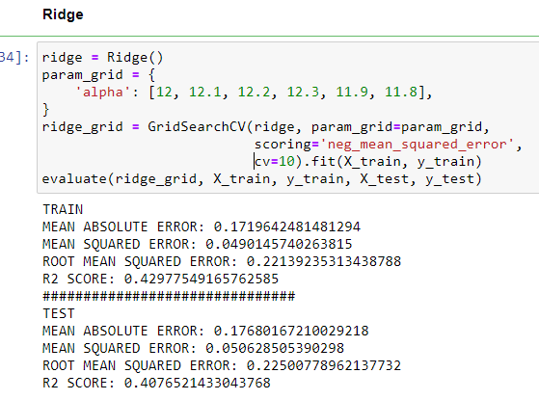
Contd..
Ridge: Ridge regression is a model tuning method that is used to analyse any data that suffers from multicollinearity. This method performs L2 regularization. When the issue of multicollinearity occurs, least-squares are unbiased, and variances are large, this results in predicted values to be far away from the actual values.

Slide 25
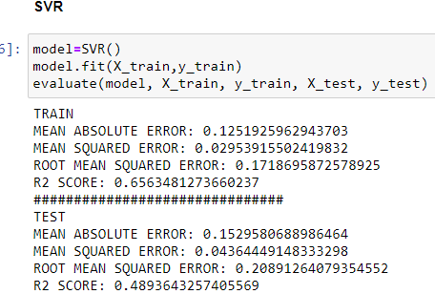
Contd…
Support Vector machine: Support Vector Regression is a supervised learning algorithm that is used to predict discrete values. Support Vector Regression uses the same principle as the SVMs. The basic idea behind SVR is to find the best fit line. In SVR, the best fit line is the hyperplane that has the maximum number of points.

Slide 26
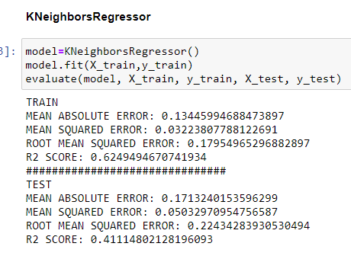
Contt..
K- Nearest Neighbors regression: KNN regression is a non-parametric method that, in an intuitive manner, approximates the association between independent variables and the continuous outcome by averaging the observations in the same neighbourhood.

Slide 27
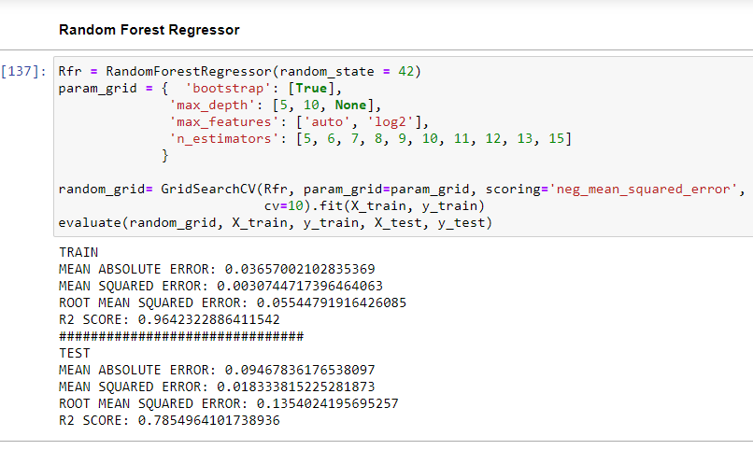
Cont..
Random Forest Regressor: Random forest is a supervised learning algorithm. The "forest" it builds, is an ensemble of decision trees, usually trained with the “bagging” method. The general idea of the bagging method is that a combination of learning models increases the overall result. Random Forest Regression is a supervised learning algorithm that uses ensemble learning method for regression. A Random Forest operates by constructing several decision trees during training time and outputting the mean of the classes as the prediction of all the trees.

Slide 28
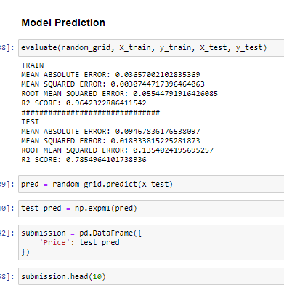
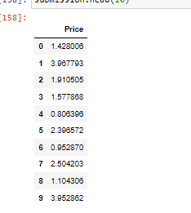
Prediction
Model Prediction Output:

Slide 29
Conclusion
- The prediction of Car price we find out that the Price is Correlated with the
1. Manufacturing Year(The year or edition of the model)
2. Power(in bhp) of the car and
3. Engine(CC) of the car
That Means if the manufacturing year of the car is recent its price is will be high
, i.e. the newer the car the higher will be the prices.
- The Power of the Lamborgini is highest among the all, while the Maserati is the expensive car producer.

Slide 30
conclusion
- Expensive company cars are sold before being driven much, while Mahindra-Renault cars are sold after driving many kilometres.
- Maruti and hyundai car brands has the most number of selling cars in India.
- In this project we use different models like Linear Regression, Lasso, Ridge, SVR, KNN Regression and Random Forest Regression.
- Random Forest is the best model for the testing and prediction.

